Slide 1
EE-2003 Computer Organization & Assembly Language
INSTRUCTOR
Engr. Kashan Hussain
AP, Department of Computer Science
FAST NUCES (Karachi)
Kashan.Hussain@nu.edu.pk

Slide 2
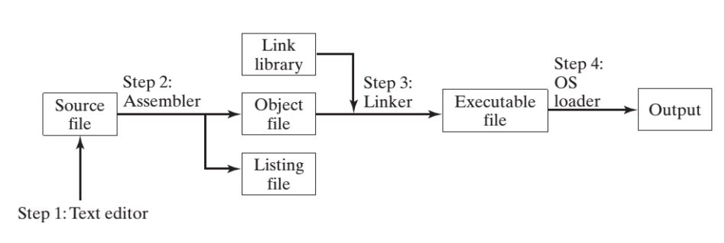
ASSEMBLING, LINKING, AND RUNNING PROGRAMS

Slide 3
ASSEMBLING, LINKING, AND RUNNING PROGRAMS
Assembler is a utility program that converts source code programs from assembly language into an object file, a machine language translation of the program. Optionally a Listing file is also produced. We’ll use MASM as our assembler.
The linker reads the object file and checks to see if the program contains any calls to procedures in a link library. The linker copies any required procedures from the link library, combines them with the object file, and produces the executable file. Microsoft 16-bit linker is LINK.EXE and 32-bit is Linker LINK32.EXE.
OS Loader: A program that loads executable files into memory, and branches the CPU to the program’s starting address, (may initialize some registers (e.g. IP) ) and the program begins to execute.
Debugger is a utility program, that lets you step through a program while it’s running and examine registers and memory
Is called Assemble-Link-Execute Cycle.

Slide 4
Listing File
A listing file contains:
a copy of the program’s source code,
with line numbers,
the numeric address of each instruction,
the machine code bytes of each instruction (in hexadecimal), and
a symbol table.
The symbol table contains the names of all program identifiers, segments, and related information.

Slide 5
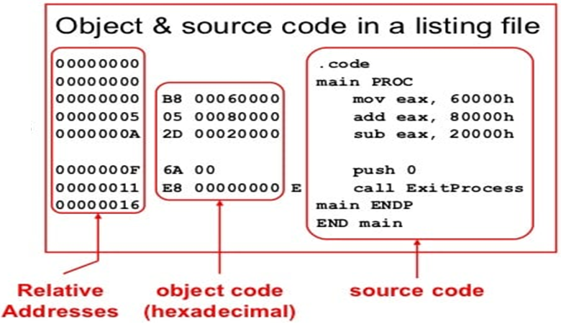
Listing File
Use it to see how your program is assembled
Contains:
source code
Object Code
Relative addresses
Segment names
Symbols
Variables
Procedure
Constants

Slide 6
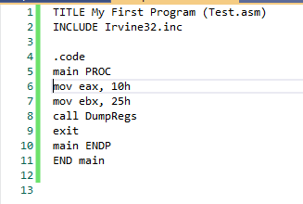
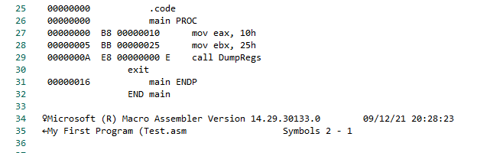
Listing File

Slide 7
Loading and Executing a Program
The operating system (OS) searches for the program’s filename in the current disk directory.
If it cannot find the name there, it searches a predetermined list of directories (called paths) for the filename.
If the OS fails to find the program filename, it issues an error message.
If the program file is found, the OS retrieves basic information about the program’s file from the disk directory, including the file size and its physical location on the disk drive.
The OS determines the next available location in memory and loads the program file into memory.
It allocates a block of memory to the program and enters information about the program’s size and location into a table (sometimes called a descriptor table).
Additionally, the OS adjust the values of pointers within the program so they contain addresses of program data.

Slide 8
Loading and Executing a Program
The OS begins execution of the program’s first machine instruction (its entry point).
As soon as the program begins running, it is called a process.
The OS assigns the process an identification number (process ID), which is used to keep track of it while running.
It is the OS’s job to track the execution of the process and to respond to requests for system resources.
Examples of resources are memory, disk files, and input-output devices.
When the process ends, it is removed from memory.

Slide 9
Basic Program Execution Registers
Registers are high-speed storage locations directly inside the CPU, designed to be accessed at much higher speed than conventional memory.
There are eight general-purpose registers (32-bit).
Six segment registers (16-bits)
A processor status flags register (EFLAGS), and an instruction pointer (EIP)

Slide 10
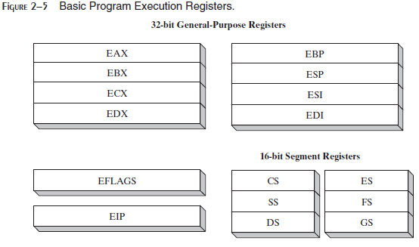
Basic Program Execution Registers

Slide 11
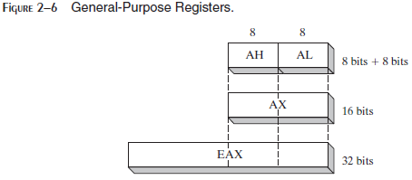
Basic Program Execution Registers
The general-purpose registers are primarily used for arithmetic and data movement.
As shown in Figure 2–6, the lower 16 bits of the EAX register can be referenced by the name AX
Portions of some registers can be addressed as 8-bit values
For example, the AX register, has an 8-bit upper half named AH and an 8-bit lower half named AL

Slide 12
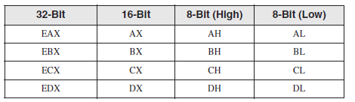
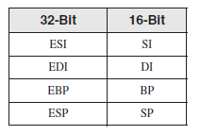
Basic Program Execution Registers
The remaining general-purpose registers can only be accessed using 32-bit or 16-bit names, as shown in the following table:

Slide 13
Specialized Uses of general-purpose registers
Data Registers (EAX, EBX, ECX, EDX): These four registers are available to the programmer for general data manipulation.
The high and low bytes of the data registers can be accessed separately.
EAX (Extended Accumulator Register) is preferred to use in in arithmetic, logic and control instructions.
EBX (Extended Base Register) is used to serve as an address register.
ECX (Extended Counter Register) serves as loop counter.
EDX (Extended Data Register) is used in multiplication and division.

Slide 14
Index Registers
Index Registers contain the offsets for data and instructions.
Offset- distance (in bytes) from the base address of the segment.
ESP (extended stack pointer register) contains the offset for the top of the stack to addresses data on the stack (a system memory structure)
ESI and EDI (extended source index and extended destination index ) points to the source and destination string respectively in the string move instructions
EBP is used to reference function parameters and local variables on the stack

Slide 15
Segment Registers
In real-address mode, 16-bit segment registers indicate base addresses of pre-assigned memory areas named segments.
In protected mode, segment registers hold pointers to segment descriptor tables (The descriptor describes the location, length and access rights of the memory segment).
Some segments hold program instructions (code), others hold variables (data), and another segment named the stack segment holds local function variables and function parameters.

Slide 16
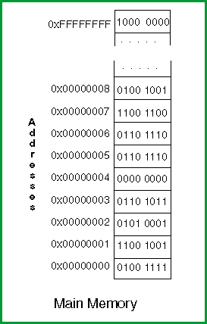
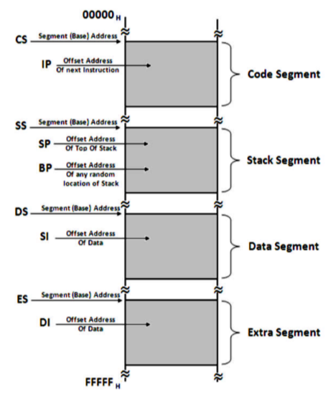
Memory

Slide 17
Segment Registers
Memory Segment: A memory segment is a block of consecutive memory bytes. Each segment is identified by a segment number, staring with 0.
Within a segment, a memory location is specified by giving an off- set. This is the number of bytes from the beginning of the segment.
A memory location may be specified by providing a segment number and an offset, written in the format segment:offset.
E.g. A4FB:4872h means offset 4872h within segment A4FBh.

Slide 18
Segment Registers
The program's code, data, and stack are loaded into different memory segments, we call them the code segment, data segment, and stack segment.
Stack segment holds local function variables and function parameters.
To keep track of the various program segments, segment register are used.
The ECS (Extended Code Segment), EDS (Extended Data Segment), and ESS (Extended Stack Segment) registers contain the code, data, and segment numbers respectively.
If a program needs to access a second data segment, it can use the EES (Extended Extra segment) register.

Slide 19
Instruction Pointer
The EIP, or instruction pointer, register contains the address of the next instruction to be executed.
Certain machine instructions manipulate EIP, causing the program to branch to a new location.

Slide 20
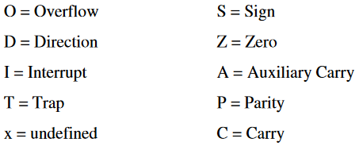
EFLAGS Register
The EFLAGS register consists of individual binary bits that control the operation of the CPU or reflect the outcome of some CPU operation.
A flag is set when it equals 1; it is clear (or reset) when it equals 0.
Programs can set individual bits in the EFLAGS register to control the CPU’s operation
For example: Interrupt when arithmetic overflow is detected

Slide 21
EFLAGS Register
There are two types of flags:
Control flags: which determine how instructions are carried out
Status flag: which report on the result operation
Control flags include:
Direction Flag (DF): affects the direction of block data transfers (like long character string) 1=up; 0= down.
Interrupt Flag (IF): determines whether interrupts can occur (whether devices like keyboard, disk drives and system clock can get the CPU’s attention to get their needs attended to.
Trap Flag (TF): determines whether the CPU is halted after every instruction. Used for debugging purposes

Slide 22
EFLAGS Register
Status flags include:
Carry Flag (CF): set when the result of unsigned arithmetic is too large to fit in the destination, 1=carry; 0=no carry.
Overflow Flag (OF): set when the result of signed arithmetic is too large to fit in the destination, 1=overflow; 0=no overflow.
Sign Flag (SF): set when an arithmetic or logical operation generates a negative result. 1=negative, 0=positive.
Zero Flag (ZF): set when an arithmetic or logical operation generates a result of zero. Used primarily in jump and loop operations, 1=zero; 0=not zero.
Auxiliary-carry Flag (AF): set when an operation causes a carry from bit3 to 4 or borrow (from bit 4 to 3), 1=carry; 0=no carry.
Parity Flag (PF): is set if the least significant byte in the result contains an even number of 1 bits. It is used to verify memory integrity.

Slide 23
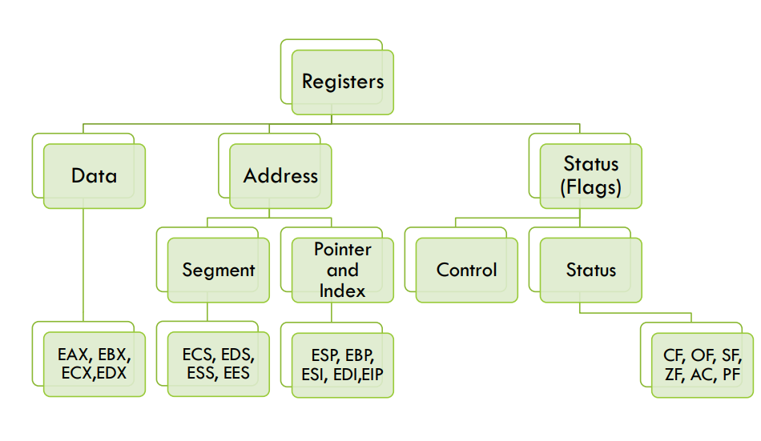
Basic Program Execution Registers

Slide 24
Mode of Operations
x86 processors have three primary modes of operation:
protected mode,
real-address mode, and
system management mode.

Slide 25
Mode of Operations
Real Address mode (original mode provided by 8086)
Only 1 MB of memory can be addressed from 0 to FFFFF (hex)
Programs can access any part of main memory
MS-DOS runs in real address mode
Implements the programming environment of the Intel 8086 processor
This mode is available in Windows 98, can be used to run MS-DOS program that requires direct access to system memory and hardware devices
Programs running in real-address mode can cause the operating system to crash (stop responding to commands)

Slide 26
Mode of Operations
Protected mode (introduced with the 80386)
Each Program can address a maximum of 4 GB of memory
The operating system assigns memory to each running program
Programs are prevented from accessing each other’s memory (segments)
Native mode used by Windows NT, 2000, XP and Linux

Slide 27
Mode of Operations
Virtual 8086 mode: A sub-mode, virtual-8086, is a special case of protected mode
Processor runs in protected mode, and creates a virtual 8086 machine with 1 MB of address space for each running Program, such as: MS-DOS
If an MS-DOS program crashes or attempts to write data into the system memory area, it will not affect other programs running at the same time
Windows XP can execute multiple separate virtual-8086 sessions at the same time
Dynamic mode
Processor runs in protected mode but simulates real
Paging 20 bit linear address to 32 bit physical address

Slide 28
Mode of Operations
System Management Mode:
Provides a mechanism for implementation power management and system security
Manage system safety functions, such as shutdown on high CPU temperature and turning the fans on and off
Handle system events like memory or chipset errors

Slide 29
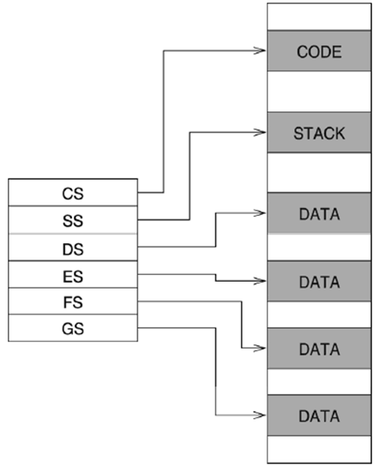
Real Address Mode
A Program can access up to six segments at any time
Code segment
Stack segment
Data Segment
Extra segments (up to 3)
Each segment is 64 KB
Logical address
Segment = 16 bits
Offset = 16 bits
Linear (physical) address = 20 bits

Slide 30
Real Address Mode
Program Segments and Segments Registers: Segment registers are used to hold base addresses for the program code, data and stack.
The code segment holds the base address for all executable instructions in the program
The data segment holds the base address for variables. This segment stores data for the program
The extra segment is an extra data segment (often used for shared data)
The stack segment holds the base address for the stack. The segment is also to store interrupt and subroutine return addresses

Slide 31
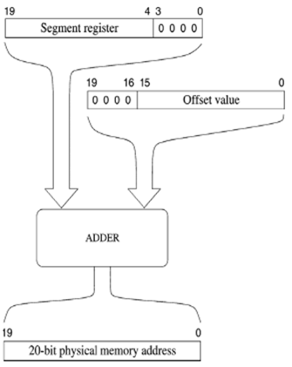
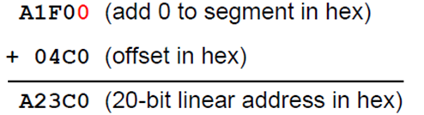
Real Address Mode
Linear address = Segments x 10 (hex) + Offset
Example:
Given:
Segment = A1F0 (hex)
Offset = 04C0 (hex)
Logical Address = A1F0:04C0 (hex)
What is linear address?
Solution:

Slide 32
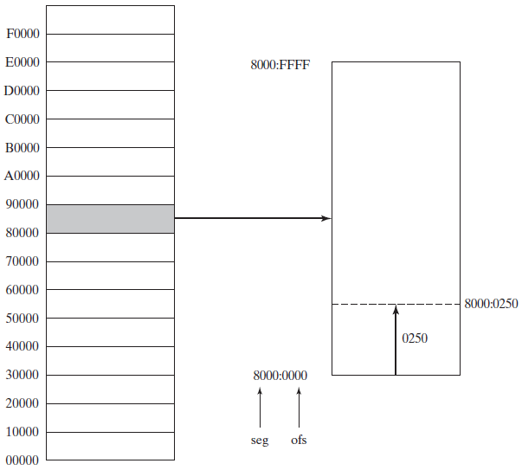
Real Address Mode

Slide 33
Address Space
In 32-bit protected mode, a task or program can address a linear address space of up to 4 GB
Extended Physical Addressing allows a total of 64 GB of physical memory to be addressed
Real-address mode programs, on the other hand, can only address a range of 1 MB
If the processor is in protected mode and running multiple programs in virtual-8086 mode, each program has its own 1-MByte memory area

Slide 34


